Slide 1
Project Title
Helmet and number plate detection system for challan generation
Presented By
Name of Students
Harsh Chouhan Roll no.50 Joydeep Das Roll no.57
Piyush Langde Roll no.68
Ishika Ukey Roll no.10

Slide 2
Under the Guidance of
Name of Guide
Prof. Sandip Desai
Name of Industry Person or Co-guide
Mr. Harsh Chordia
-

Slide 3
Contents
Introduction
Problem Statement
Flowchart
Literature Survey
Methodology
Work done till now
References

Slide 4
Introduction
This project aims to develop an integrated system for real-time helmet detection and number plate recognition on two-wheelers, to enhancing road safety, traffic regulation. The vehicle identification by number plates , unique Indian traffic context & rider as well as helmet & non helmet. It will detect.
We aim to observe whether the person wears a helmet or not, using YOLO deep learning framework. We establish the improvement of a strategy using deep convolutional neural networks for revealing motorcycle riders who disobey the laws.
Helmets are proven to significantly reduce the severity of head injuries in the event of accidents.
Compliance with helmet usage is a fundamental aspect of road safety.

Slide 5
Problem statement
"Increasing cases of non-compliance with helmet regulations on Indian roads contribute to a heightened risk of head injuries and accidents. This project addresses this issue by developing an 'Intelligent Helmet Detection' system that utilizes computer vision to identify riders without helmets in real-time, facilitating automated challan generation for effective enforcement of helmet usage and enhancing overall road safety."

Slide 6
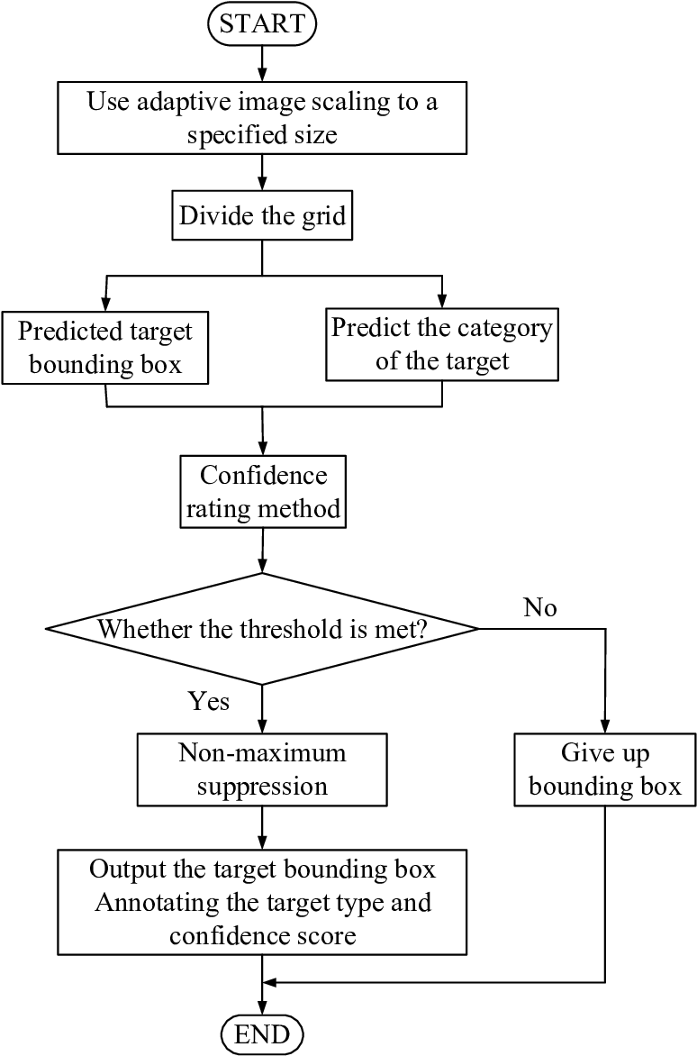
Flow Chart:-

Slide 7
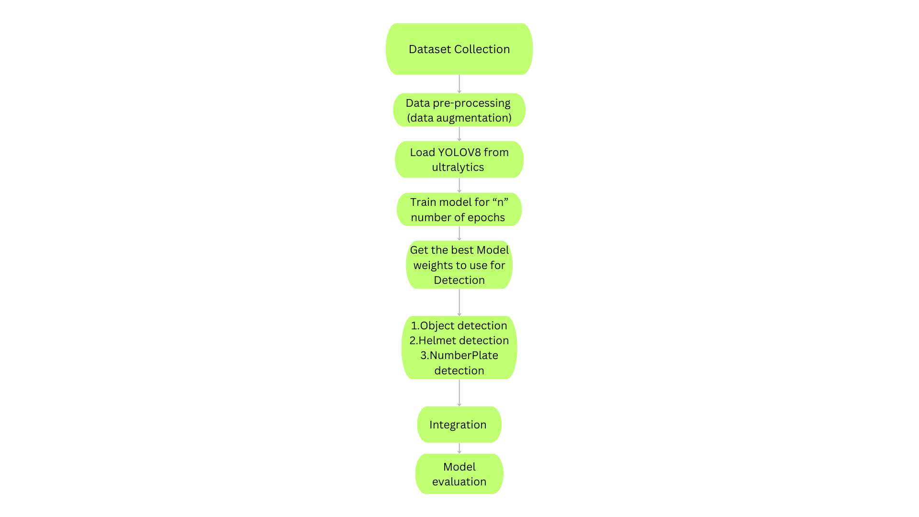

Slide 8
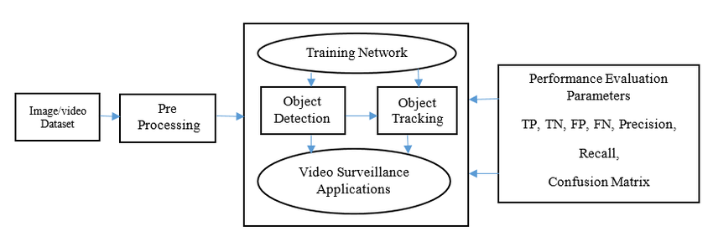
Flow Chart

Slide 9
Research gap
1. Limited Focus on Two-Wheeler Safety
Existing studies predominantly concentrate on general object detection or vehicle tracking, with minimal emphasis on the nuanced safety concerns associated with two-wheeler riders. Our project uniquely centers on the detection of helmet usage in real-time scenarios, a critical factor in mitigating road accidents involving motorcyclists.
2. Real-Time Precision in Complex Environments:
Many contemporary object detection systems struggle in real-time applications, especially in dynamically changing environments like busy city roads. Our project addresses this gap by leveraging the efficiency of the YOLOv algorithm, enabling accurate and swift detection of helmets on moving two-wheeler riders amidst varying traffic conditions.

Slide 10
Research gap
3. Edge Device Deployment for Practical Implementation
While sophisticated algorithms exist, there is a dearth of practical solutions tailored for deployment on edge devices like Raspberry Pi. Recognizing the importance of accessibility and real-world implementation, our project not only develops a robust detection model but also ensures its compatibility and efficiency on resource-constrained edge computing platforms.
4. Holistic Integration of Transfer Learning Techniques:
While transfer learning has gained prominence, its full potential in the context of helmet detection for two-wheelers remains largely unexplored. Our project integrates transfer learning to leverage knowledge from a broader dataset, enhancing the model's ability to generalize and adapt to the specific challenges posed by helmet detection.

Slide 11
Literature survey
Artificial intelligence (AI) algorithms are capable of making decisions based on real time data, thanks to advancements in storage systems, processing speeds, and analytic techniques. They can analyze data from various sources, adapt and learn from their decisions, and make complex decisions. AI in conjunction with machine learning and data analytics can identify patterns and trends in data to solve practical problems. In the transportation industry, AI is used in semi-autonomous and fully autonomous vehicles to navigate and make real-time decisions based on traffic conditions. AI systems also have the ability to recognize and interpret images, such as license plates, using computer vision and character recognition algorithms. Optical Character Recognition (OCR) techniques, such as feed-forward neural networks, are used to translate scanned images of printed text into machine-encoded text. Different techniques, such as feature extraction and statistical classifiers, can be used to improve the accuracy of OCR systems. However, each system has its own advantages and disadvantages
Existing Solutions:
Various solutions exist for helmet detection, ranging from traditional image processing techniques to modern deep learning approaches. While some may rely on color-based segmentation, others leverage convolutional neural networks (CNNs) for more accurate object detection.

Slide 12
Literature survey
Computer Vision Techniques:
Computer vision techniques such as Haar cascades, YOLO (You Only Look Once), and Faster R-CNN (Region-based Convolutional Neural Network) have been applied to object detection tasks. Understanding these techniques is crucial for implementing an effective helmet detection system.
Challenges and Gaps:
Previous studies often face challenges such as occlusions, varying lighting conditions, and the need for real-time processing. Addressing these challenges is essential to improve the robustness and reliability of helmet detection systems.
Real-world Implementations:
Real-world implementations, like the deployment of helmet detection systems in smart cities or traffic management, showcase the practical applicability of such technology. Case studies on successful deployments provide insights into system effectiveness and user acceptance.

Slide 13
Literature survey
Legal and Ethical Considerations:
The implementation of surveillance and enforcement systems raises legal and ethical considerations. Research exploring the legal frameworks, privacy concerns, and public perception of such systems informs the responsible development and deployment of your solution.
Transfer Learning and Pre-trained Models:
Many projects leverage transfer learning and pre-trained models to expedite training and improve performance. Understanding how transfer learning has been applied in helmet detection or related tasks informs your approach to model development.
Recent Advancements:
Stay abreast of recent advancements in object detection and computer vision. Innovations like efficient model architectures (e.g., EfficientNet), self-supervised learning, or advancements in transfer learning techniques may influence the design choices for your project.

Slide 14
Methodology
Data Collection:
"To kickstart our project, we embarked on a comprehensive data collection phase. We sourced relevant data for helmet detection and vehicle information on Indian roads. This included obtaining image datasets, video footage, and other pertinent data from various sources."
Data Preprocessing:
"In order to ensure the quality and uniformity of our data, we implemented various preprocessing techniques. This involved tasks such as resizing images, applying data augmentation methods, and normalization processes to enhance the overall quality of our dataset."
Object Detection Models:
"Our project heavily relies on sophisticated object detection models. We employed state-of-the-art models like YOLO, which were instrumental in accurately detecting both vehicles and helmets. For helmet detection specifically, we delved into the intricacies of model training to achieve optimal performance."

Slide 15
Methadology
Integration of Models:
In the integration phase, we focused on harmonizing the outputs of multiple models to create a unified and efficient system. Our project involves two primary tasks: vehicle detection and helmet detection. Each of these tasks requires specialized models, and the challenge lies in orchestrating their collaboration.
1 Vehicle Detection Model:
The vehicle detection model is responsible for identifying and localizing vehicles within a given frame. We employed a robust object detection model, such as YOLO (You Only Look Once), which excels in real-time object detection scenarios. This model was fine-tuned on datasets containing diverse vehicle types commonly found on Indian roads.
2 Helmet Detection Model:
For helmet detection, a separate model was trained to identify the presence and location of helmets within the region of interest (ROI). This model underwent specific training to recognize helmets, considering variations in helmet design, lighting conditions, and other factors

Slide 16
Methadology
Deployment:
"Taking our project from development to deployment will be a significant milestone. We will carefully considered the deployment environment, addressing hardware considerations, particularly on platforms like Raspberry Pi. The deployment process will be designed to seamlessly integrate our system into real-world applications."

Slide 17
Work done till now
Data Collection:
Acquired a diverse dataset capturing real-world scenarios on Indian roads and outside. Emphasized the importance of a comprehensive dataset for training and evaluating the model's performance.
Preprocessing:
Performed preprocessing tasks to ensure the dataset's quality and compatibility with the YOLOv8 model. This involved resizing images, normalizing pixel values, and applying augmentation techniques to enhance model generalization.
YOLOv8 Model Integration:
Integrated the YOLOv8 model, a state-of-the-art object detection algorithm, into the project. Explained how YOLOv8 is well-suited for real-time applications and highlighted its ability to handle multiple objects in a single pass.

Slide 18
Work done till now
Workflow:-
"In the preliminary stages of our project, we successfully implemented a robust object detection system using YOLO (You Only Look Once). This framework enabled us to identify and classify diverse objects within the road environment, ranging from vehicles and pedestrians to the crucial element of safety gear – helmets. Moving beyond general object detection, we extended our capabilities to include the specialized recognition of number plates on vehicles.
The integration of these features lays the foundation for an intelligent traffic rule detection system. By leveraging YOLO's efficiency, we not only achieve real-time object identification but also ensure the accurate detection of specific elements critical for traffic monitoring and safety. The culmination of these efforts represents a significant step towards creating a comprehensive solution for intelligent traffic rule detection and compliance.
As we progress, our focus remains on refining and optimizing these detection mechanisms, incorporating innovative approaches to enhance accuracy and efficiency. The project's ultimate goal is to contribute to road safety by creating a system that aids in the enforcement of traffic rules through intelligent detection and analysis."

Slide 19
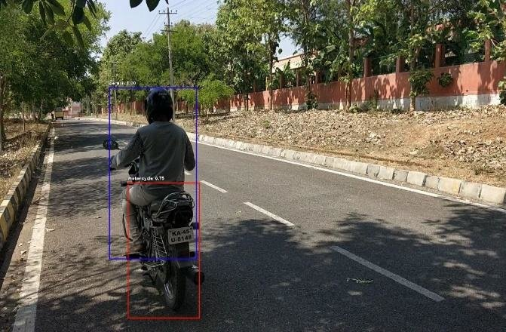
Work done till now
Object Detection:-
Successfully implemented object detection techniques, particularly focusing on detecting two-wheelers, by utilizing pre-trained YOLOv model.
Integrated the YOLOv model with OpenCV for real-time object detection on images and video streams.
Demonstrated the ability to draw bounding boxes around detected objects, providing a visual representation of the detection process.

Slide 20
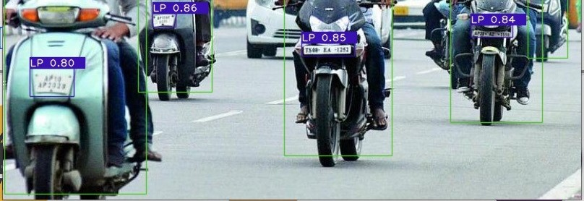
Work done till now
NumberPlate Detection:-
In the number plate detection module, Plate Recognizer API played a pivotal role in extracting valuable information from the detected vehicle number plates.
Integrated the number plate detection module with the overall system, facilitating the recognition of alphanumeric characters on the detected plates.
Ensured seamless integration of both helmet and number plate detection

Slide 21
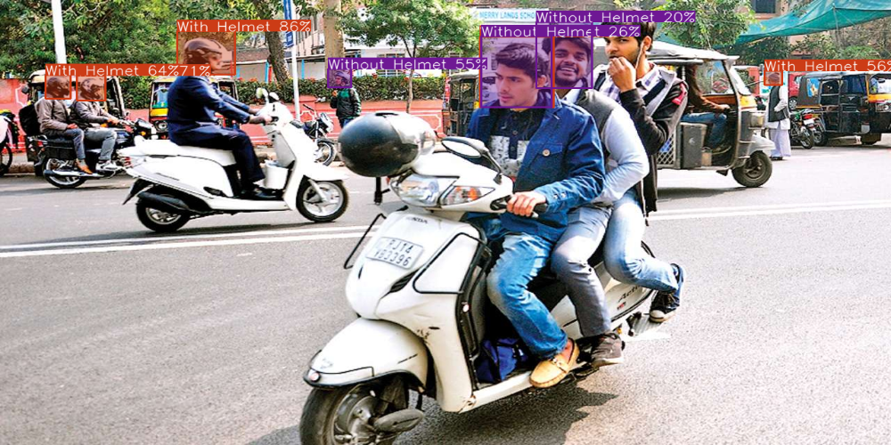
Work done till now
Helmet Detection-
Implemented a specialized module for helmet detection, utilizing transfer learning and fine-tuning on a pre-trained YOLOv model.
Achieved accurate identification and localization of helmets in the given images or video frames.
Incorporated the YOLOv model's ability to recognize multiple classes, enabling the system to distinguish between helmets and other objects.

Slide 22
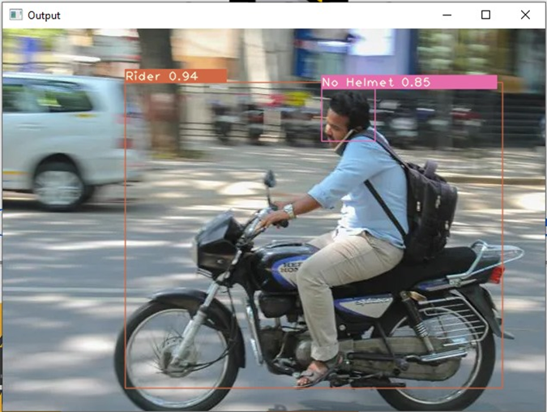
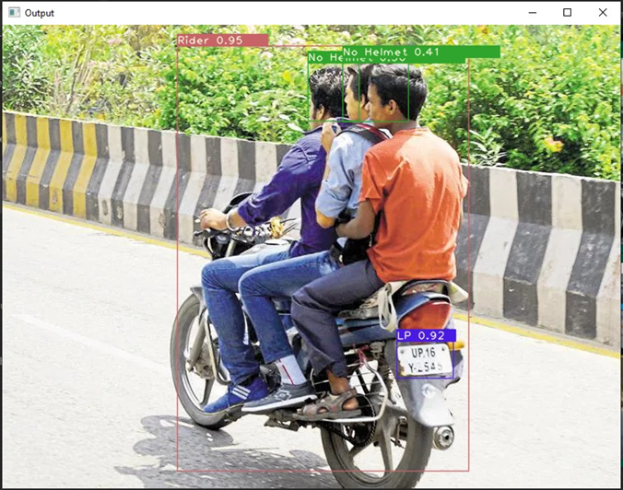
Integration of models

Slide 23
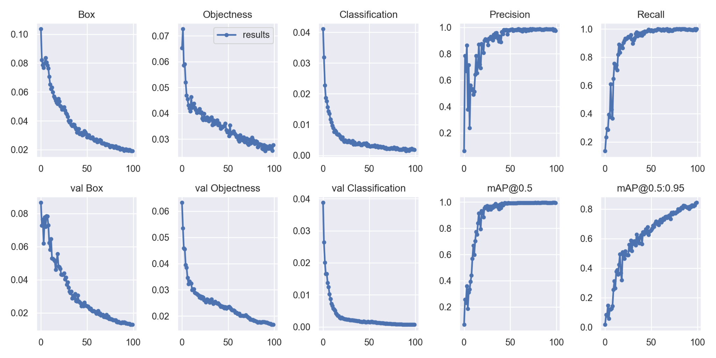
Performance evaluation parameters

Slide 24
Project utility
The intelligent helmet detection system developed in this project holds substantial utility in enhancing road safety and law enforcement on Indian roads. Its applications span across various domains, providing tangible benefits to different stakeholders.
1. Road Safety Enhancement:
Primary Goal: The project addresses the critical issue of helmet compliance among two-wheeler riders. By accurately detecting helmet usage in real-time, it contributes significantly to improving road safety.
2. Compliance Monitoring:
Law Enforcement Support: The system aids law enforcement agencies in monitoring and enforcing helmet compliance efficiently. Automated detection reduces the burden on law enforcement officers, allowing them to focus on other aspects of road safety.
3. Traffic Management:
Data-Driven Decision Making: The collected data from the system can be utilized for traffic management insights. It provides valuable information about helmet usage patterns, contributing to data-driven decision-making for traffic planning and optimization.

Slide 25
Project utility
4. Accident Prevention:
Preventing Two-Wheeler Accidents: Ensuring that riders wear helmets is a proactive measure to prevent severe head injuries in case of accidents. The system contributes to minimizing the impact of accidents by promoting helmet usage.
5.Public Awareness:
Education and Awareness Campaigns: The project can be leveraged to support public awareness campaigns. Visualizations and statistics derived from the system's data can be used in educational initiatives to highlight the importance of wearing helmets..

Slide 26
References
https://pjreddie.com/darknet/yolo/
https://github.com/pjreddie/darknet/blob/master/data/coco.names
https://docs.opencv.org/4.x/
https://www.researchgate.net/publication/351411017_Real-Time_Object_Detection_Using_YOLO_A_Review
https://github.com/HumanSignal/labelImg
https://valueml.com/helmet-detection-using-tensorflow-and-keras/
https://tiwarinitin1999.medium.com/yolov3-custom-object-detection-with-transfer-learning-47186c8f166d
https://github.com/TheSiddheshFulawade/Helmet-Detection-and-Number-Plate-Recognition-Using-YOLO
https://arxiv.org/abs/2304.08256

Slide 27
THANK YOU

